Slide 1
Wisoft Computer Basic
PC & Network
정보통신
20131792
LEE SEONG WON

Slide 2
01
wisoft Computer Basic
Mainboard
Power Supply
CPU
SSD
RAM
HDD
VGA
10.2%
90.2%

Slide 3
02
wisoft Computer Basic
CPU
Central Processing Unit

Slide 4
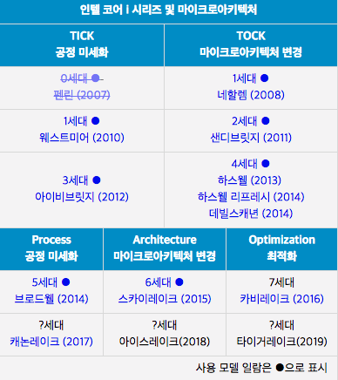
03
wisoft Computer Basic

Slide 5
04
wisoft Computer Basic

Slide 6
05
wisoft Computer Basic

Slide 7
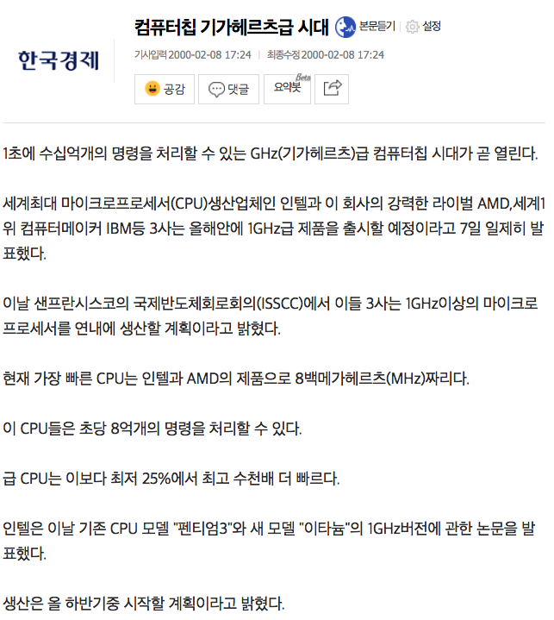
06
wisoft Computer Basic

Slide 8
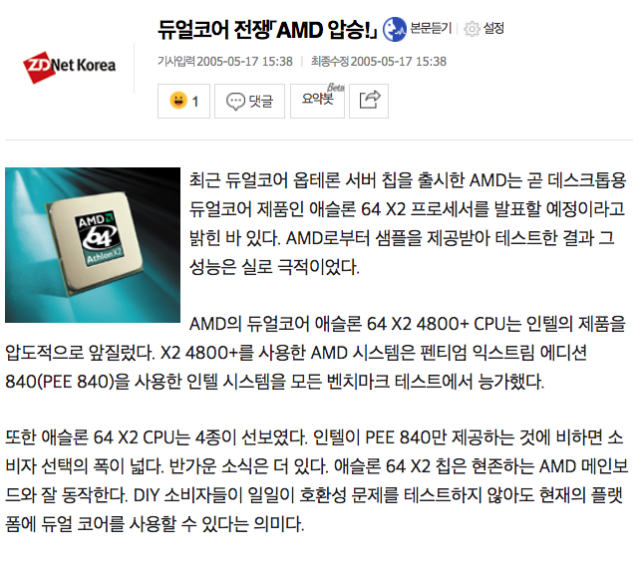
07
wisoft Computer Basic

Slide 9

08
wisoft Computer Basic
희대의 망작, 두번타는 보일러

Slide 10
09
wisoft Computer Basic

Slide 11
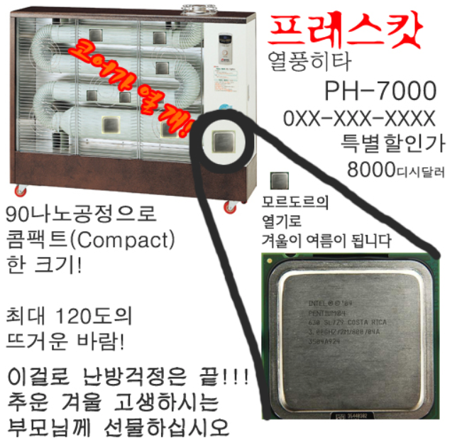
10
wisoft Computer Basic

Slide 12
11
wisoft Computer Basic

Slide 13
12
wisoft Computer Basic
인텔의 역습 11년 장기집권의 시작

Slide 14
13
wisoft Computer Basic
CPU의 내부는 어떤모습일까요?

Slide 15
14
wisoft Computer Basic
RAM
RAM
Random Access Memory

Slide 16
15
wisoft Computer Basic
RAM

Slide 17
16
wisoft Computer Basic
RAM

Slide 18
17
wisoft Computer Basic
HDD & SSD

Slide 19
18
wisoft Computer Basic
HDD & SSD

Slide 20
19
wisoft Computer Basic
VGA

Slide 21
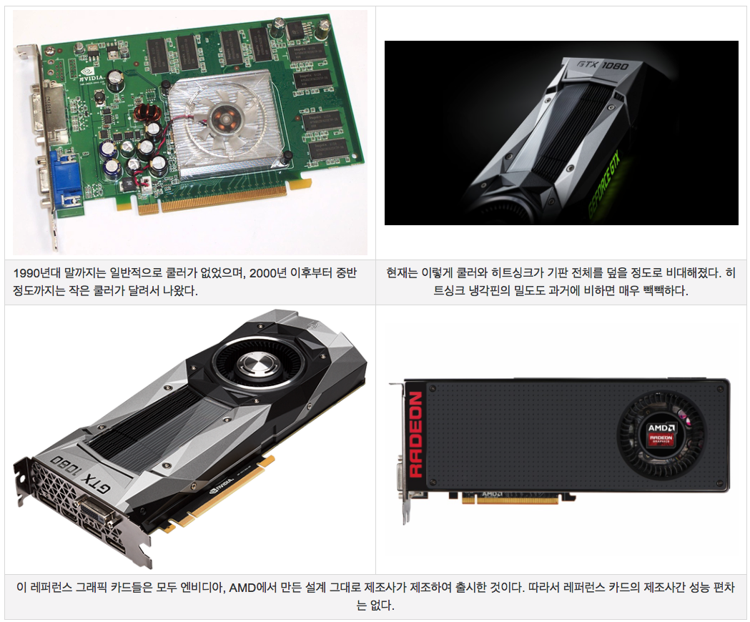
20
wisoft Computer Basic
VGA

Slide 22
20
wisoft Computer Basic
Advanced

Slide 23
21
wisoft Computer Basic
Q&A

